Slide 1
Tutorial 1 Learning Topology Optimization Through Examples and Case Studies
August 18, 2019

Slide 2
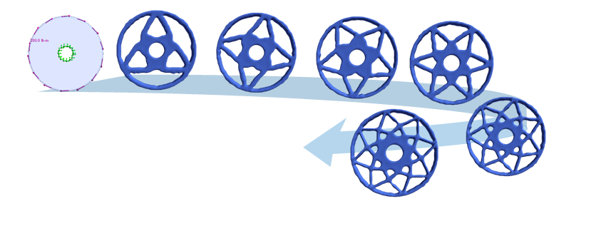
Non-Uniqueness of Designs

Slide 3
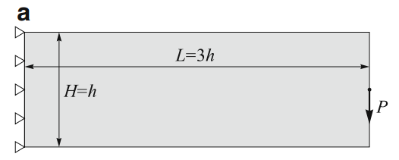
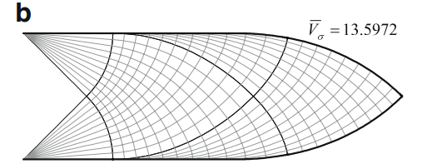
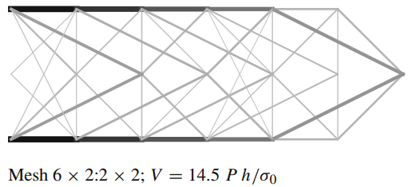
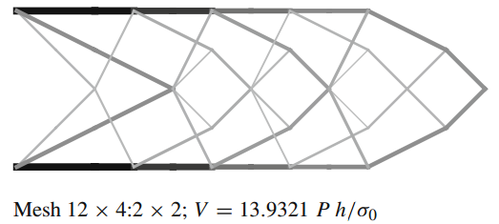
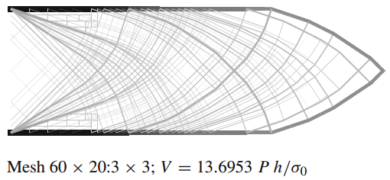
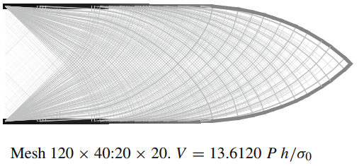
Motivation
Sokół, T., 2011. A 99 line code for discretized Michell truss optimization written in Mathematica. Structural and Multidisciplinary Optimization 43, 181–190.

Slide 4
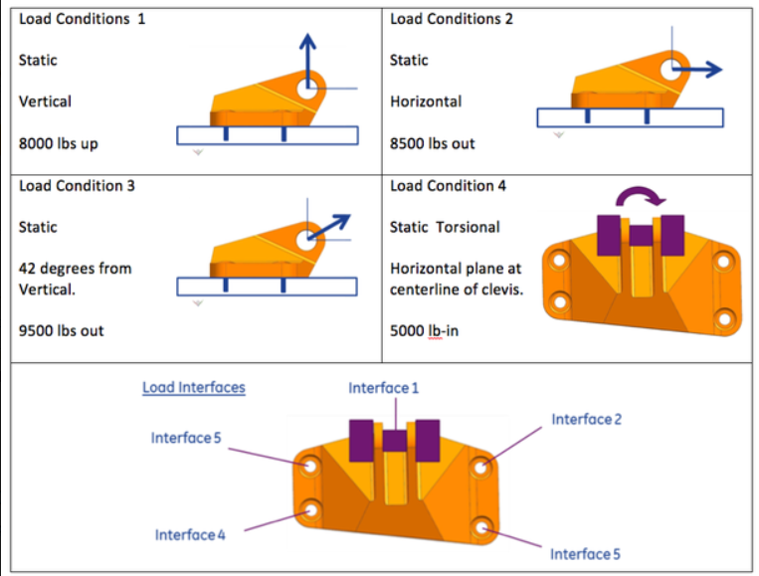
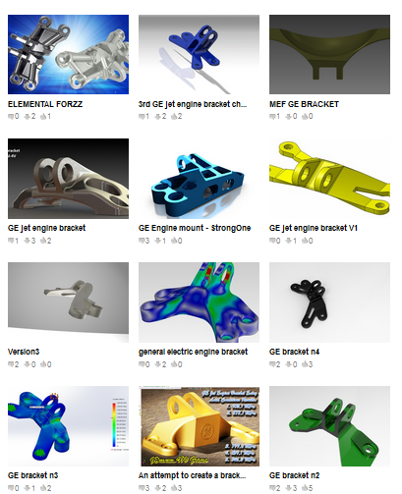
GE GrabCAD Design Challenge
Hundreds of designs
were submitted!

Slide 5
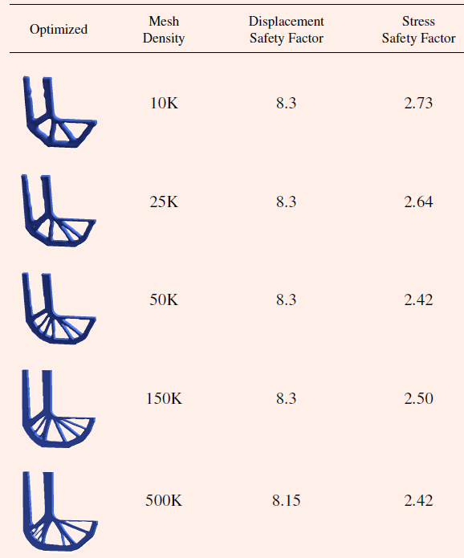
Mesh Density
Mesh density increases
Thinner features
More complex designs
Increase in computation time
Generally reduction in
stress safety factor
Stress safety factor remains
between 2.40 and 2.75!

Slide 6
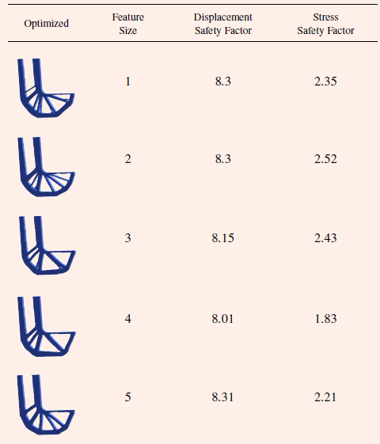
Minimum Feature Size
Minimum feature size increases
Thicker features
Easier to fabricate
Stress safety factor remains
between 8.01 and 8.31!

Slide 7
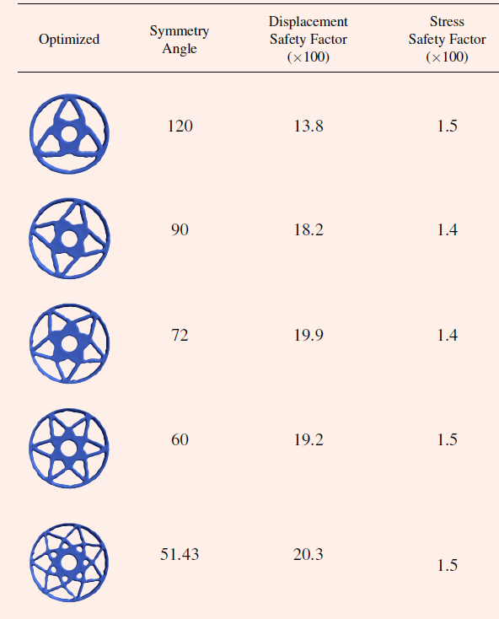
Cyclic Symmetry
Symmetry angle decreases
Thinner features
More complex designs
Stress safety factor remains
between 1.4 and 1.5!

